Slide 1

CMP1101: PN Junction

Slide 2
PN Junction
 | n-type | p-type
Impurity | Pentavalent donor | Trivalent acceptor
Conduction | Electrons | Holes (deficit conduction)
Majority carriers | Electrons | Holes
Minority carriers | Holes | Electrons
PN junction:
Boundary/interface between p-type and n-type inside a single crystal of semiconductor.
Created by doping – ion implantation, diffusion or epitaxy
If 2 separate pieces of material were used, this would produce a grain boundary that would severely inhibit its utility by scattering the electrons and holes.
Elementary building blocks most semiconductor electronic devices.
Are the active sites where electronic action takes place in a semiconductor device.
Schottky junction: special type of p-n junction where metal serves the role of the p-type semiconductor.

Slide 3
PN Junction Characteristics
Both the p-type and n-type semiconductors are relatively conductive.
However, the p-n junction can become depleted of carriers, thus becoming non-conductive.
This depends on the relative voltages between the two semiconductor regions.
This non-conductive layer can be exploited/manipulated
Thus p-n junctions are commonly used as diodes
Circuit elements that allow for the flow of electricity in one direction and not the other.

Slide 4
PN Junction Bias
Bias is the application of a voltage across a PN junction.
Zero bias – no voltage applied.
Forward bias – direction of easy current flow.
Reverse bias – direction of little or no current flow.
Zero bias (Equilibrium): No external voltage applied to the PN junction
After joining the p-type and n-type semiconductors to create a PN junction:
Electrons from the n-region near the p-n junction tend to diffuse into the p region leaving behind positively charged ions in the n region.
These free electrons recombine with holes in the p region thus creating negatively charged ions.
Equilibrium condition is reached in which a potential difference is formed across the junction.
This potential difference is called the built-in voltage, V_{bi}.

Slide 5
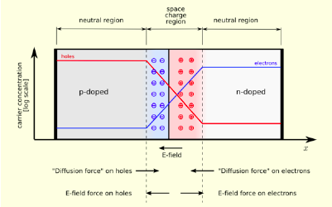
PN Junction: Zero Bias

Slide 6
Zero Bias Forces
Electric field (E-field)
Created by the space charge region
Opposes the diffusion process for both holes and electrons.
Two concurrent phenomena:
The diffusion process tends to create more space charge
The electric field created by the space charge counteracts the diffusion process
Space charge region:
Has a net charge provided by the fixed ions left behind by majority carrier diffusion.
When equilibrium is reached, the charge density is approximated by the step function.

Slide 7
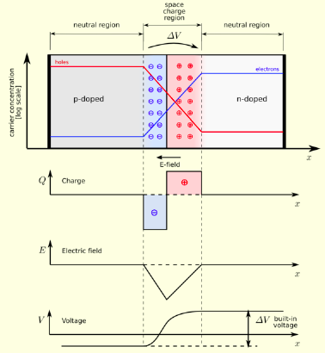
Zero Bias Forces - Graphically

Slide 8

Forward Bias
Positive Terminal
Negative Terminal
p-type is connected to the positive terminal, while the n-type is connected to the negative terminal.
With the battery connected this way,
The positive potential applied to the p-type repels the holes while the negative potential at the n-type repels the electrons.
The holes in the p-type region and the electrons in the n-type region are pushed towards the junction and begin to neutralize the depletion zone.

Slide 9
Forward Bias cont’d
With increasing forward bias voltage:
The depletion zone keeps decreasing
It becomes thin enough that the zone’s electric field cannot oppose carrier diffusion across the junction.
Electric resistance is consequently reduced.
Electrons cross the junction into the p-type material.
However, majority electron carriers do not continue to flow indefinitely.
It’s energetically favorable for them to recombine with the holes.
Diffusion length: average length an electron travels through the p-type material before recombination.
Typically of the order of micrometers.

Slide 10
Forward Bias – Current Flow
Current flow thus involves:
Electrons flowing through the n-type region towards the junction.
Holes flow through the p-type region (opposite to electron flow) towards the junction.
The two species of carriers constantly recombine in the vicinity of the junction.

Slide 11
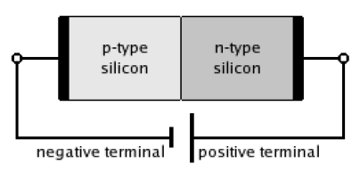
Reverse Bias
p-type is connected to the negative terminal, while the n-type is connected to the positive terminal.
With the battery connected this way,
The holes in the p-type material are pulled away from the junction.
This leaves behind charged ions and consequently causing the width of the depletion zone to grow.
The electrons in the n-type region are pulled away from the junction as well with similar effects.

Slide 12
Reverse Bias cont’d
The increase in the voltage barrier causes a high resistance to the flow of charge carriers.
Thus allowing minimal current flow to cross the p-n junction.
The increase in the resistance of the p-n junction results in the junction behaving as an insulator.
The strength of the depletion zone electric field increases as the reverse bias voltage increases.
Once the electric field intensity increase beyond a critical level, the p-n junction depletion zone breaks down and the current begins to flow.
By the Zener or the avalanche breakdown process.
Both breakdown processes are non-destructive and reversible as long as the current flow does not reach a level that causes thermal damage to the semiconductor.

